Slide 1
Simulations
New topic. This topic will be used as content for your next assessment.
You should be working through the probability questions on mathspace T3W1_Homework to do revision on probability ready for the test
EQ – How do I calculate the probability of an expected event?

Slide 2
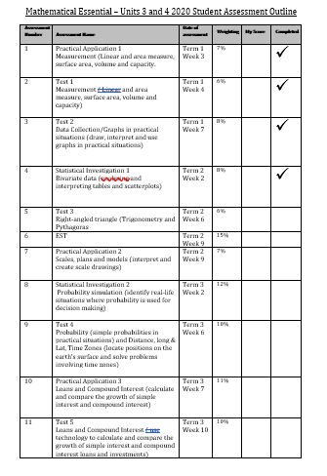

Slide 3
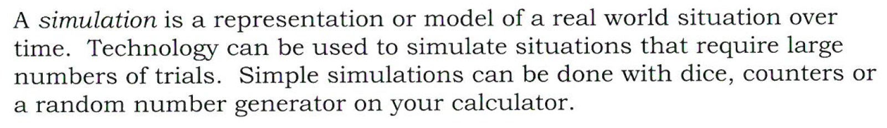
24
7
30
Simulations
Date
EQ – How do we run simulations?
What is a Simulation?

Slide 4
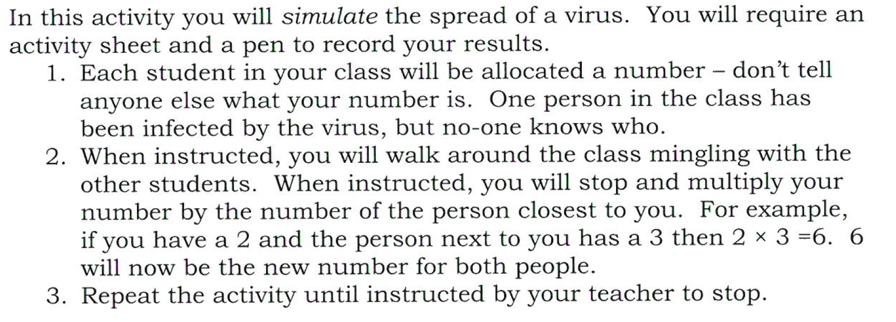
Simulation Activity

Slide 5


Slide 6
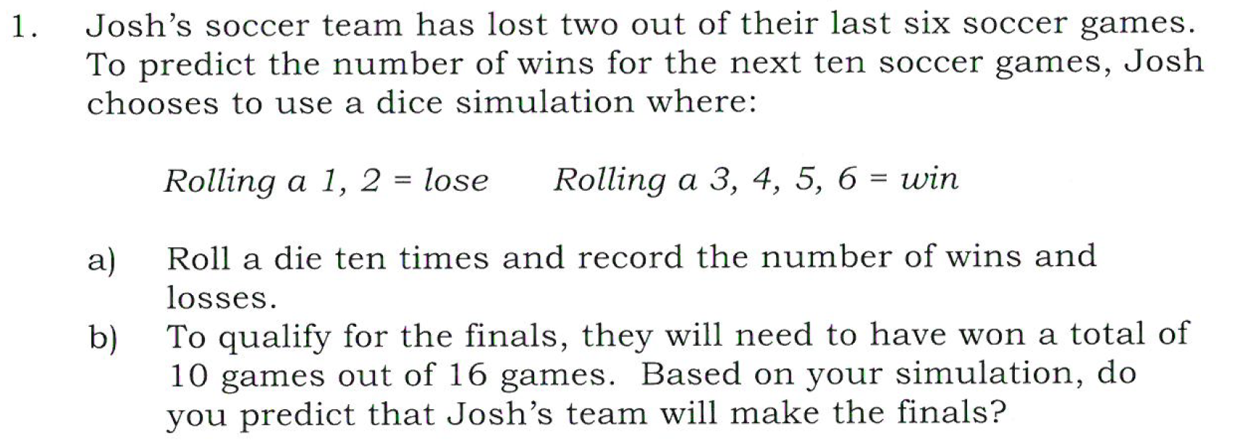
Task

Slide 7
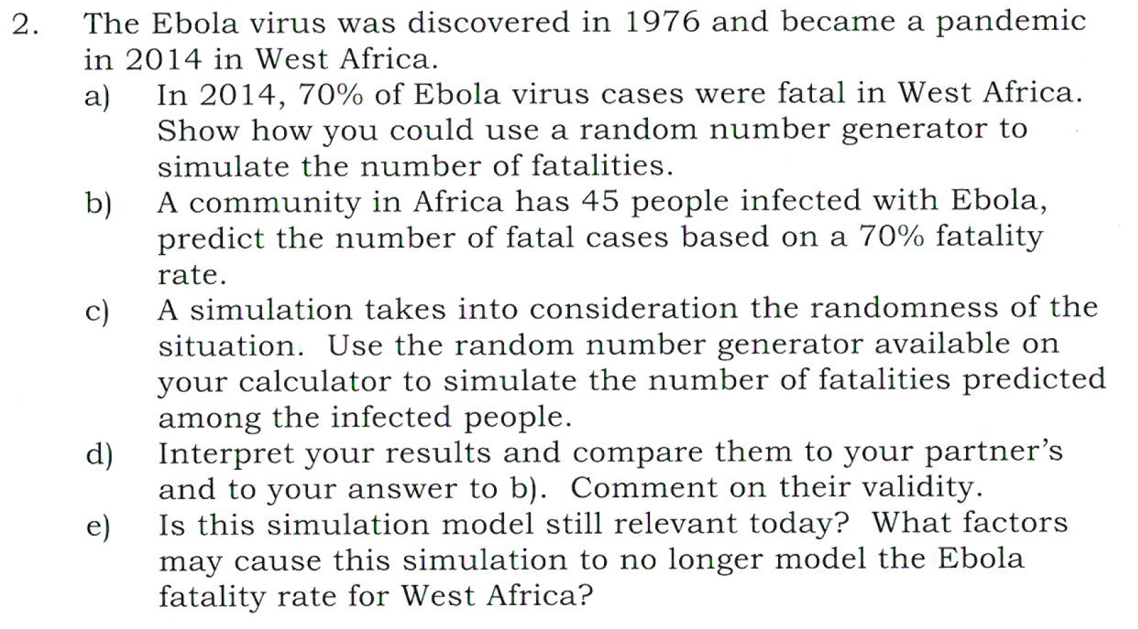
Task
https://www.google.com.au/search?q=random+number+generator&ie=&oe=
Notes:
Use scientific calculator: alpha- decimal- add in numbers use shift ) to put comma in between

Slide 8
Task
Tasty Burger task class task
- 1 lesson practice for Inv
https://www.google.com.au/search?q=random+number+generator&ie=&oe=

